Slide 1
Chatbot with API.AI
Kevin - 2017

Slide 2
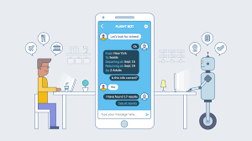
Introduce
What is Chatbot?
Kinds of chatbot ?
Chatbot in action
Future UI ?

Slide 3
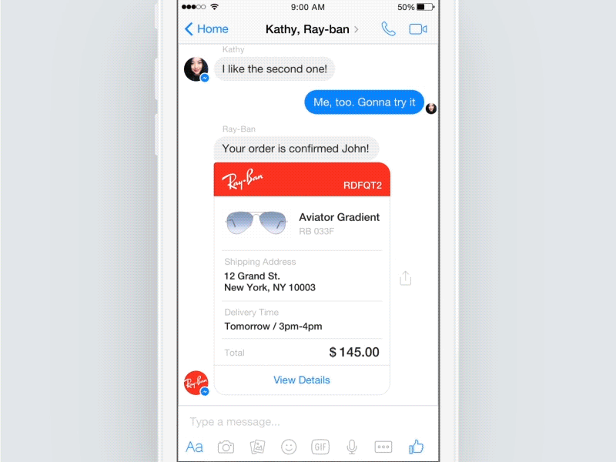

Slide 4
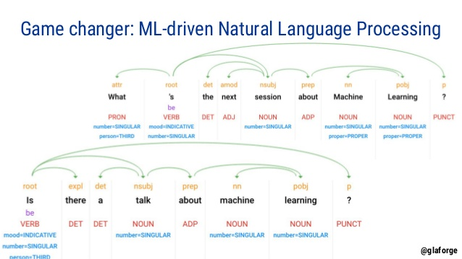
NLP

Slide 5
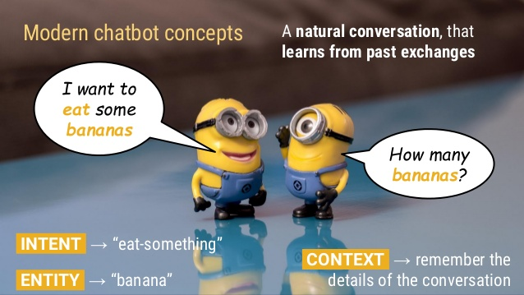
Concepts
Intent
Entity
Context
Fulfillment

Slide 6

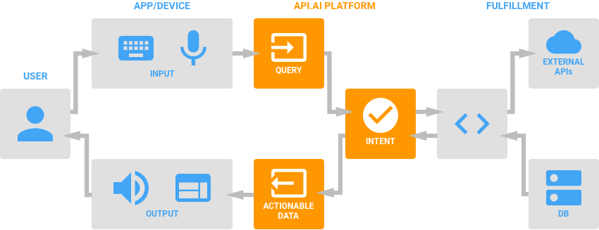
API.AI

Slide 7
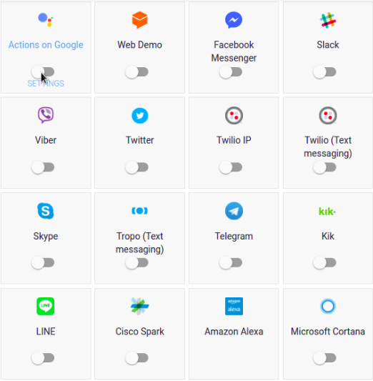
User interaction
Desktop Application
Web Application
Mobile Application
Virtual Assistant : Contana, Google assistant
Devices:
PC
Mobile
Smart sound : Amazon Echo, Google Home
How to ?
Text
Speech

Slide 8
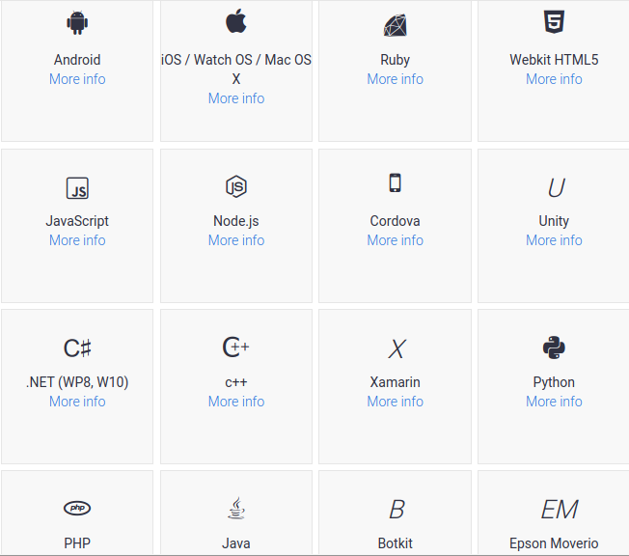
Fulfillment support
Multi languages support
Server side with REST and JSON
Serverless with Goolge, Amazon, Azure

Slide 9


Severless with Google Function
Serverless ?
Google Function

Slide 10
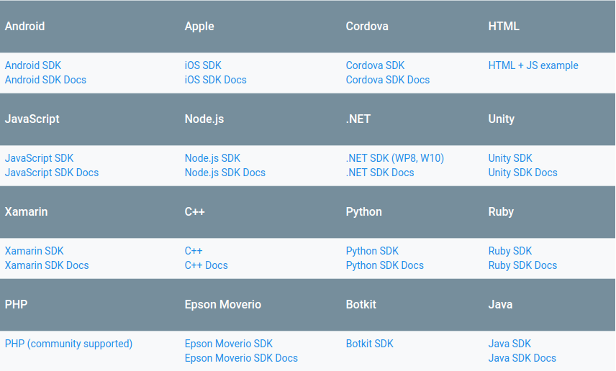
Server side SDK

Slide 11
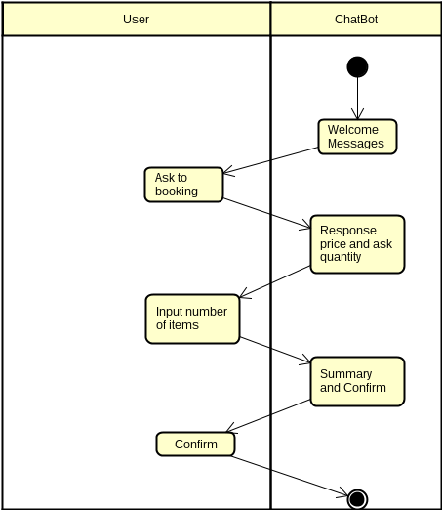
Application flow
Step 1 : welcome message
Step 2 : user ask to book
Step 3 : chatbot response price, ask quantity
Step 4 : user input number items
Step 5 : chatbot summary
Step 6 : user confirm
Step 7 : end

Slide 12
Build frontend
Add libraries : ai.api.libai & ai.api.libai.web.libai-web-servlet
Generate Client token from API.AI
Create Servlet with client token
Submit request and show response

Slide 13
Build backend
Add libraries : ai.api.libai & ai.api.libai.web.libai-web-servlet
Extends AIWebhookServlet
Create a security layer (ex : basic auth)
Make services handle actions
Deploy to internet
Register fulfillment to API.AI

Slide 14
References
api.ai
actions.google.com
cloud.google.com
vnkotlin.com

Slide 15
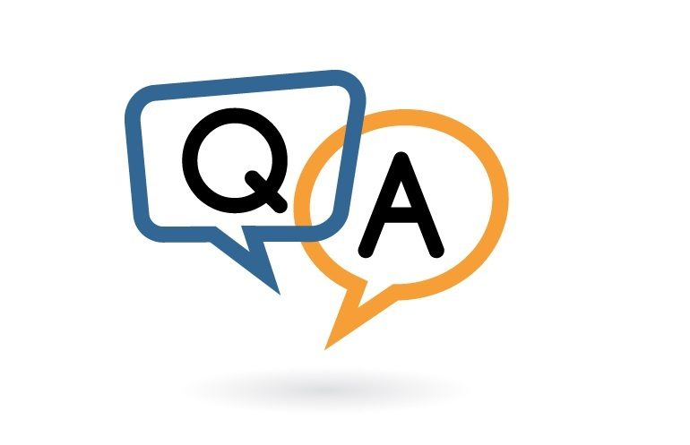
"simple but not simpler"

